Slide 1
Cloud Computing and Big Data Containers and cloud native DevOps
Oxford University
Software Engineering Programme
July 2021

Slide 2
Contents
Containers
History and Approach
Docker
Docker ecosystem
PaaS in a container model
Futures

Slide 3
Sharing of resources vs Isolation
Dedicated data centre
Dedicated HW/ Shared Datacentre
More isolation
Virtual Machines
Containers
Shared OS Separate processes
Shared
Process
Better resource utilisation

Slide 4
Lightweight Virtualization history
zSystems Virtual Servers from late 1990s
(the mainframe really did do everything first)
Solaris Containers
AIX Workload Partitions
FreeBSD Jail
…

Slide 5
What is a Container?
A lightweight virtual server
Running within an Operating System
Providing various levels of isolation and control
E.g. Disk isolation and control
Network isolation
CPU and memory controls

Slide 6
Containers at Google
Every GMail session is a container
Try doing an export and then searching your email ☺
“Everything runs in a container”
2 billion containers launched a week
Borg
Any Google developer can instantiate their code in 10,000 instances any time they want
Takes about 5 minutes to start that many
Never exactly 10,000 because of failures

Slide 7
Linux Containers (LXC)
Virtualization inside the Linux Operating System
Not the only Linux option, but the most popular
Allows virtualization including CPU, memory, disk
Simple and effective

Slide 8
cgroups
Control of resources by process:
blkio — this subsystem sets limits block devices such as physical drives
cpu - access to the CPU.
cpuacct — this reports on CPU usage
cpuset — this controls usage by CPUs in a multicore
devices — this denies or grants access to devices
freezer — suspends and resumes tasks
memory — controls and reports on memory usage
net_cls — tags network packets with ids for control
net_prio — priority of network traffic per interface.
ns — the namespace subsystem.

Slide 9
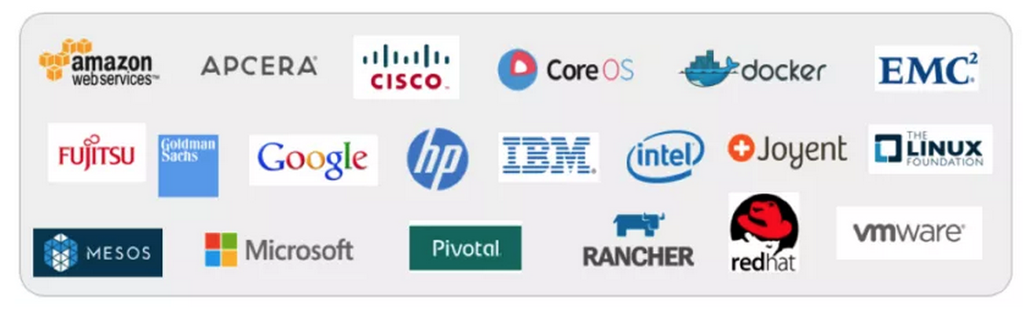
libcontainer and the Open Container Foundation
A standardised interface into the container layer
Part of runC the open runtime from Docker
A key basis of the Open Container Foundation

Slide 10
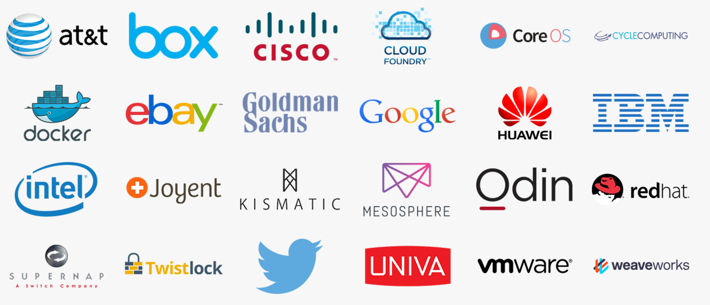
Cloud Native Computing Foundation
A new definition of “Cloud Native”
Container Packaged
Dynamically Managed
Micro-Service oriented

Slide 11
Docker on top of LXC
Docker adds several things to LXC and containerization:
Copy on write filesystem
Layered images and the ability to extend machines easily
Simple textual config file
Portable deployment across machines
Creating an ecosystem of images
Application centric
Each VM is a process (roughly speaking)
Plus others (auto-build, etc)

Slide 12
Why Docker?
The ecosystem has created a network effect
Metcalfe’s Law states
the value of a telecommunications network is proportional to the square of the number of connected users of the system
There is surely a corollary for ecosystems

Slide 13
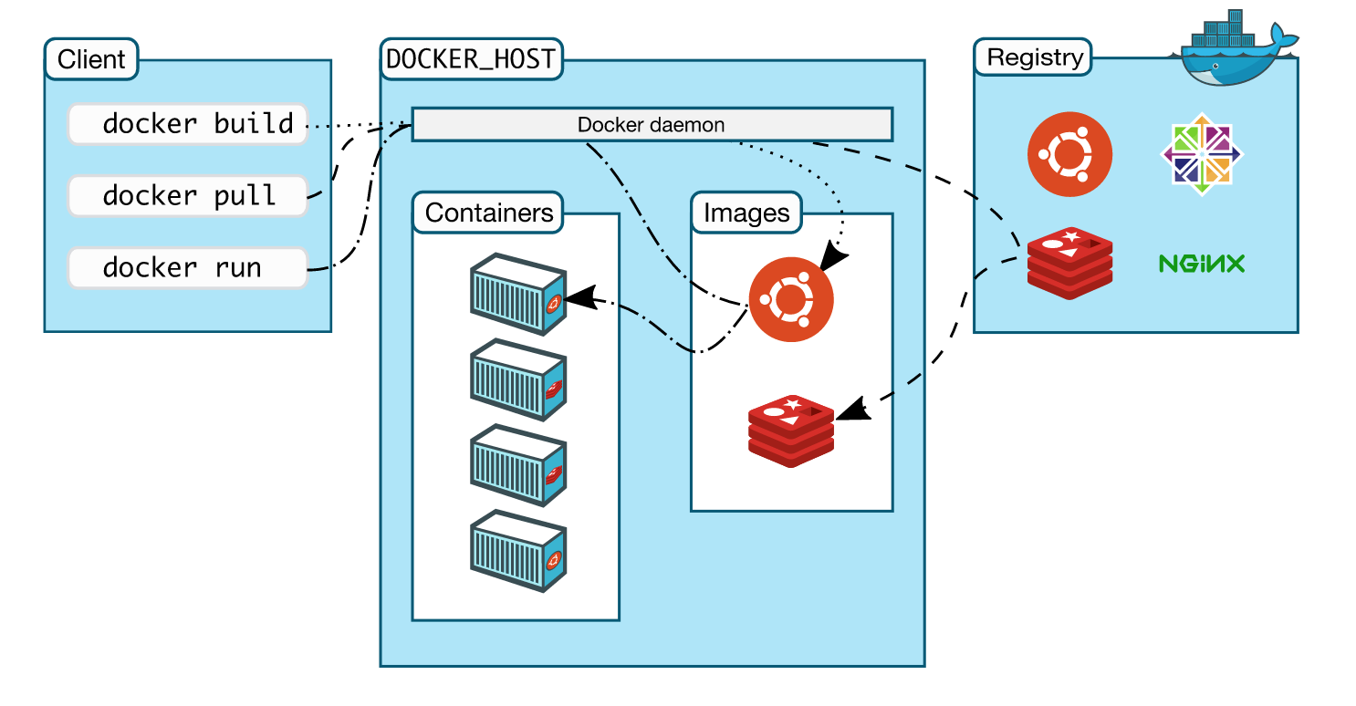
How does Docker work?

Slide 14
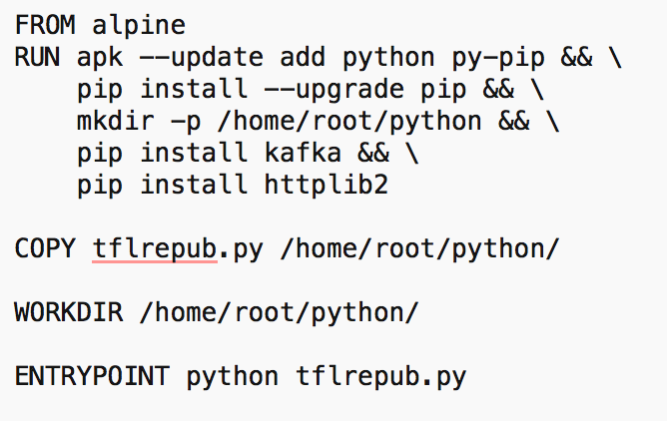
Dockerfile

Slide 15
Some simple Docker commands
apt-get install docker.io
docker pull ubuntu
docker run –t –i ubuntu /bin/bash
docker ps
docker commit funky_freo image
docker push image

Slide 16
Docker Compose
A way of configuring multiple Docker containers
Solves security issues
Shouldn’t put secrets in Dockerfile or Docker image
Manages dependencies between containers

Slide 17
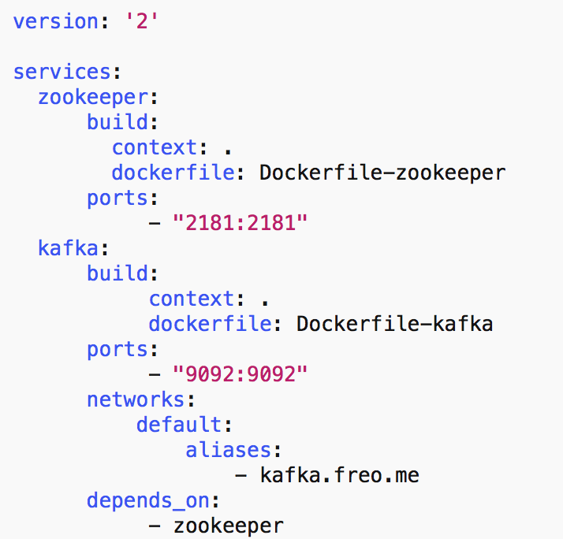
docker-compose.yml

Slide 18
Docker Machine
Manages docker servers
e.g. VirtualBox, Amazon, DigitalOcean
Let’s you start/stop and configure Docker to talk to the remote server
Unfortunately Docker-Machine is no longer maintained :-(

Slide 19
Cloud Orchestration
What does an Operating System do?
Manages processes
Co-ordinates the processes access to resources
CPUs
Memory
Disk
Devices
Fairness and priority between processes

Slide 20
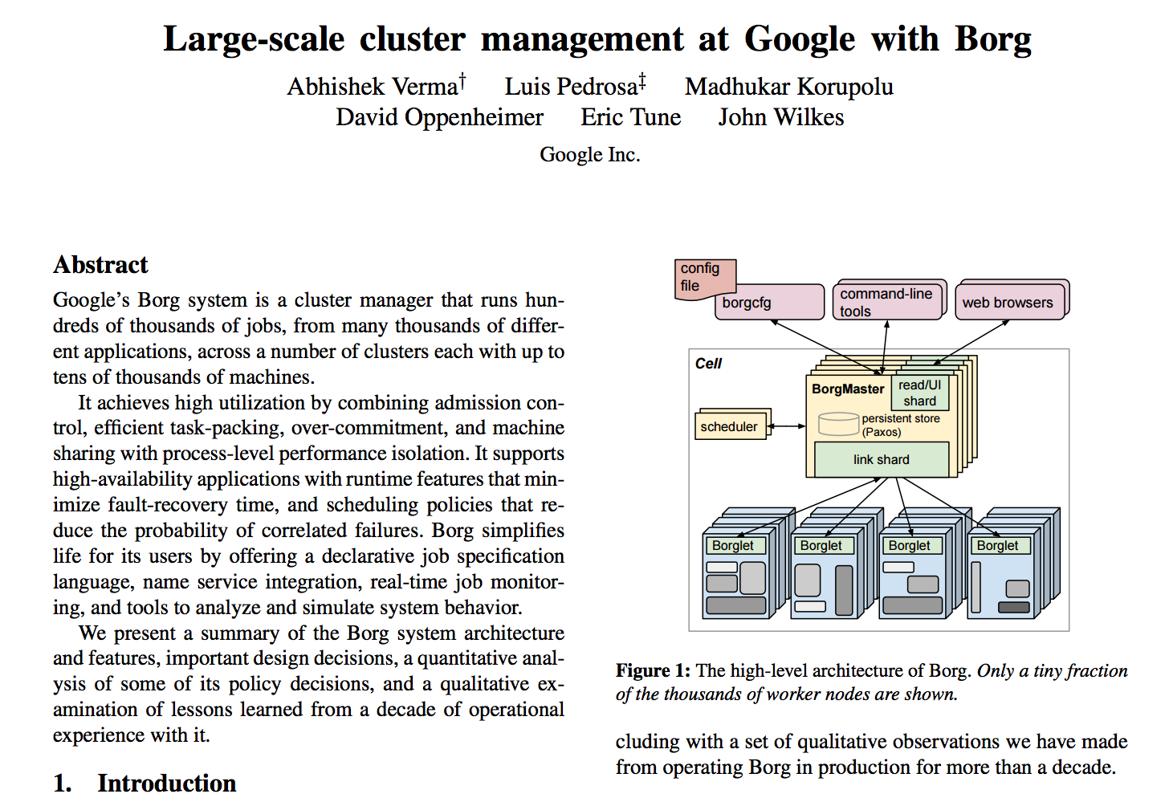

Slide 21
Datacenter Operating System aka Container Orchestration
Manages the placement of containers
Access to resources
Configuration and networking
Moves containers
Load balances across containers
Effectively creating a single OS across a cloud
Containers vs Processes

Slide 22
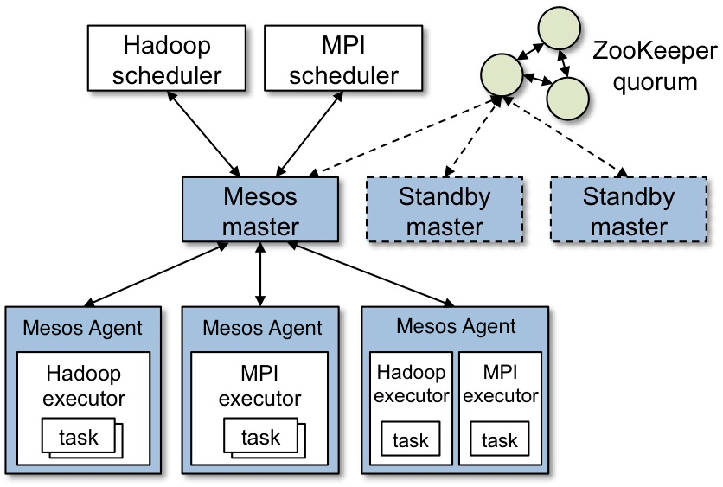
Apache Mesos

Slide 23
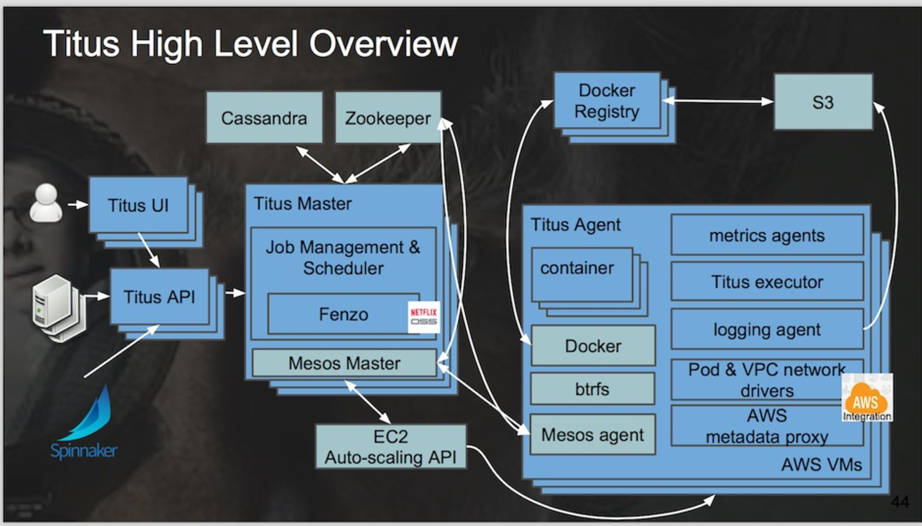
Netflix Titus
Running on 5000 AWS instances (m4.4xlarge and r3.8xlarge) Three regions
10,000 containers running at any time
1,000,000 containers launched
https://www.infoq.com/news/2017/07/netflix-titus

Slide 24
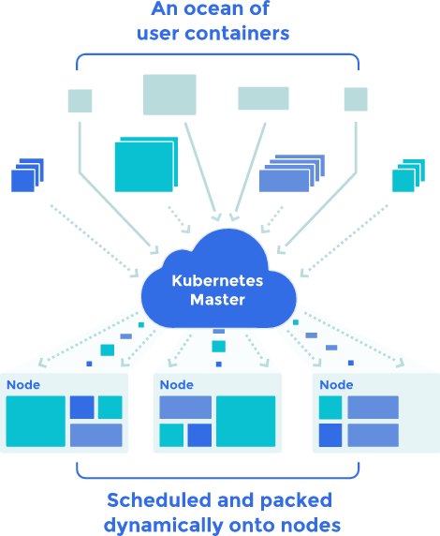
Kubernetes
Open Source cluster management of containers
From Google, but separate from the Borg project

Slide 25
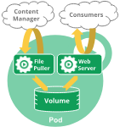
Pods
A Pod encapsulates an application container (or, in some cases, multiple containers), storage resources, a unique network IP, and options that govern how the container(s) should run.
A Pod represents a unit of deployment: a single instance of an application in Kubernetes, which might consist of either a single container or a small number of containers that are tightly coupled and that share resources.

Slide 26
Services
An abstract exposure of pods
Pods die and are recreated, replicated
“A Kubernetes Service is an abstraction which defines a logical set of Pods and a policy by which to access them”

Slide 27
Volumes
A persistent virtual disk that belongs to a Pod
Shares data between containers
Lives longer than a container, but no longer than the pod

Slide 28
Namespaces
A virtual cluster
Names must be unique inside namespaces, can be the same across different namespaces

Slide 29
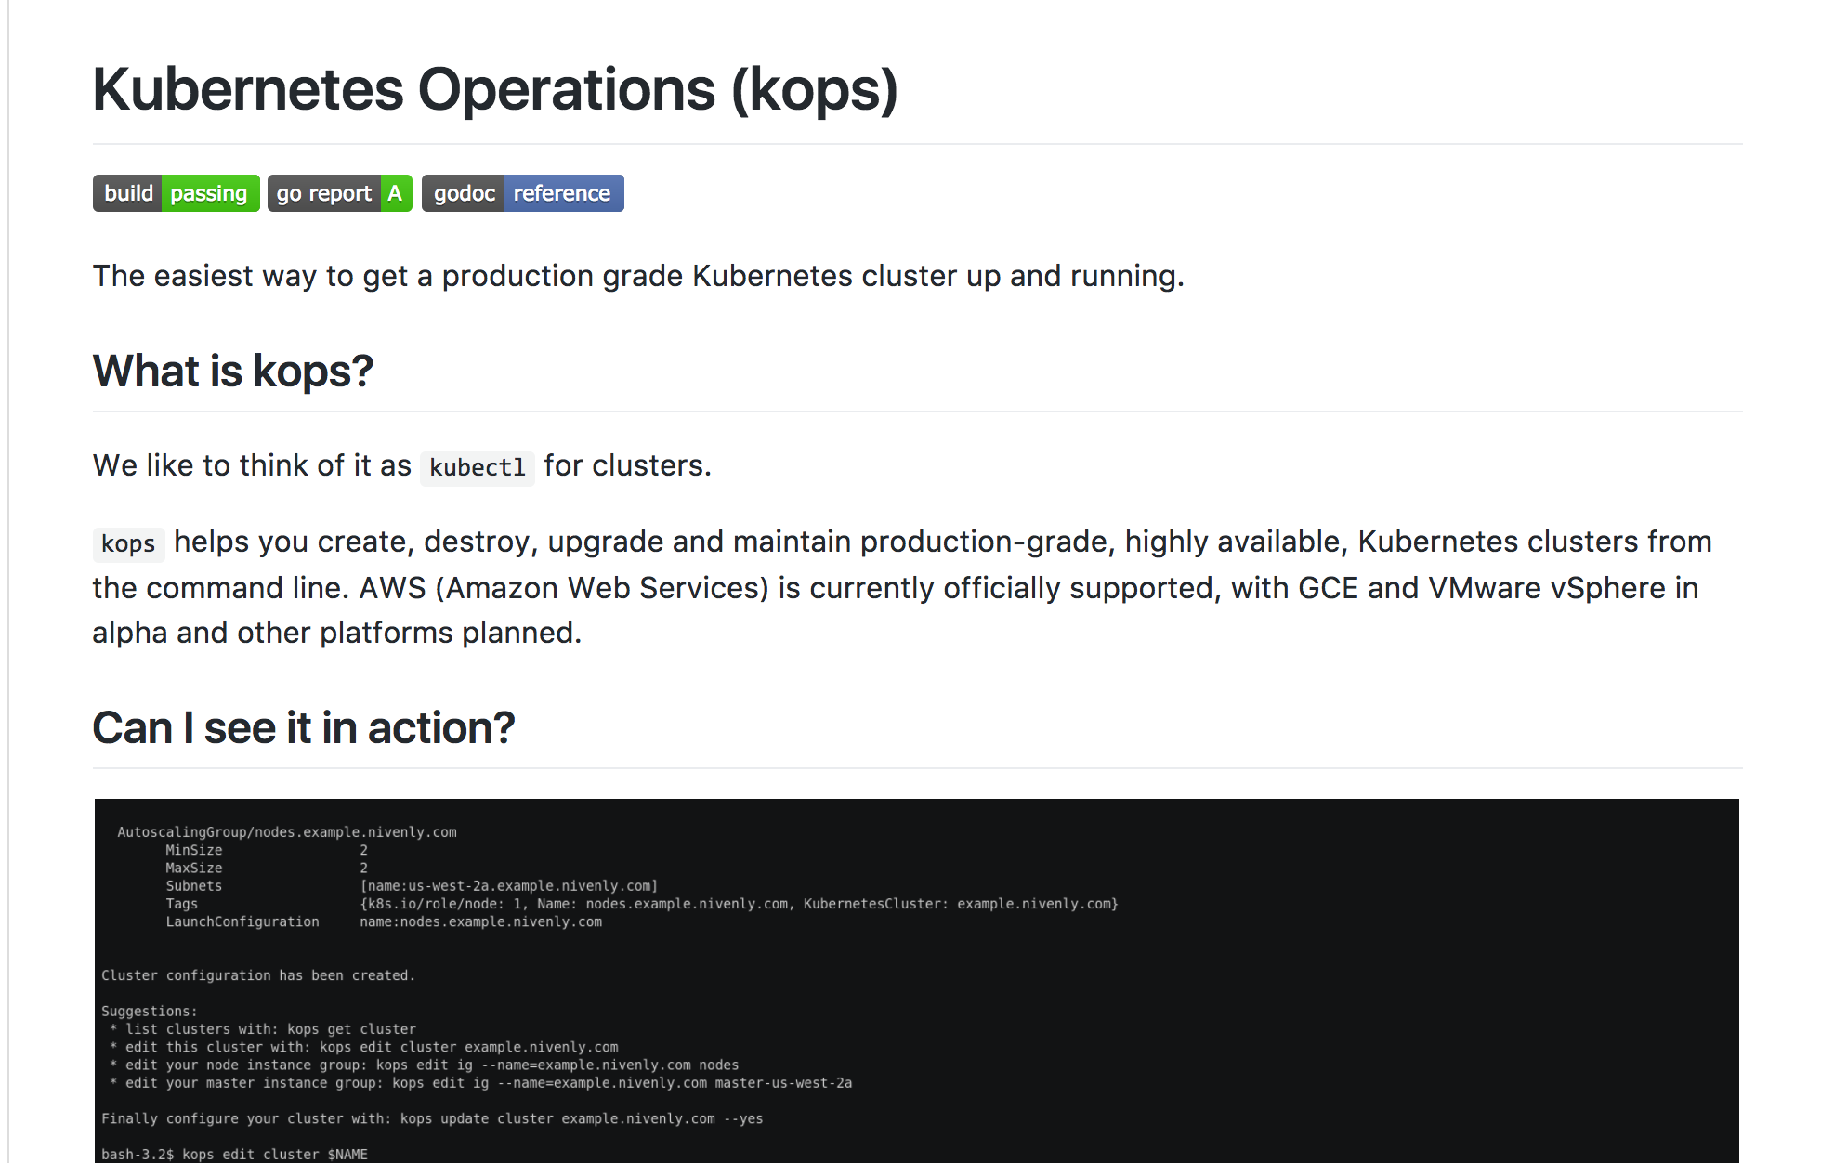
KOPS

Slide 30
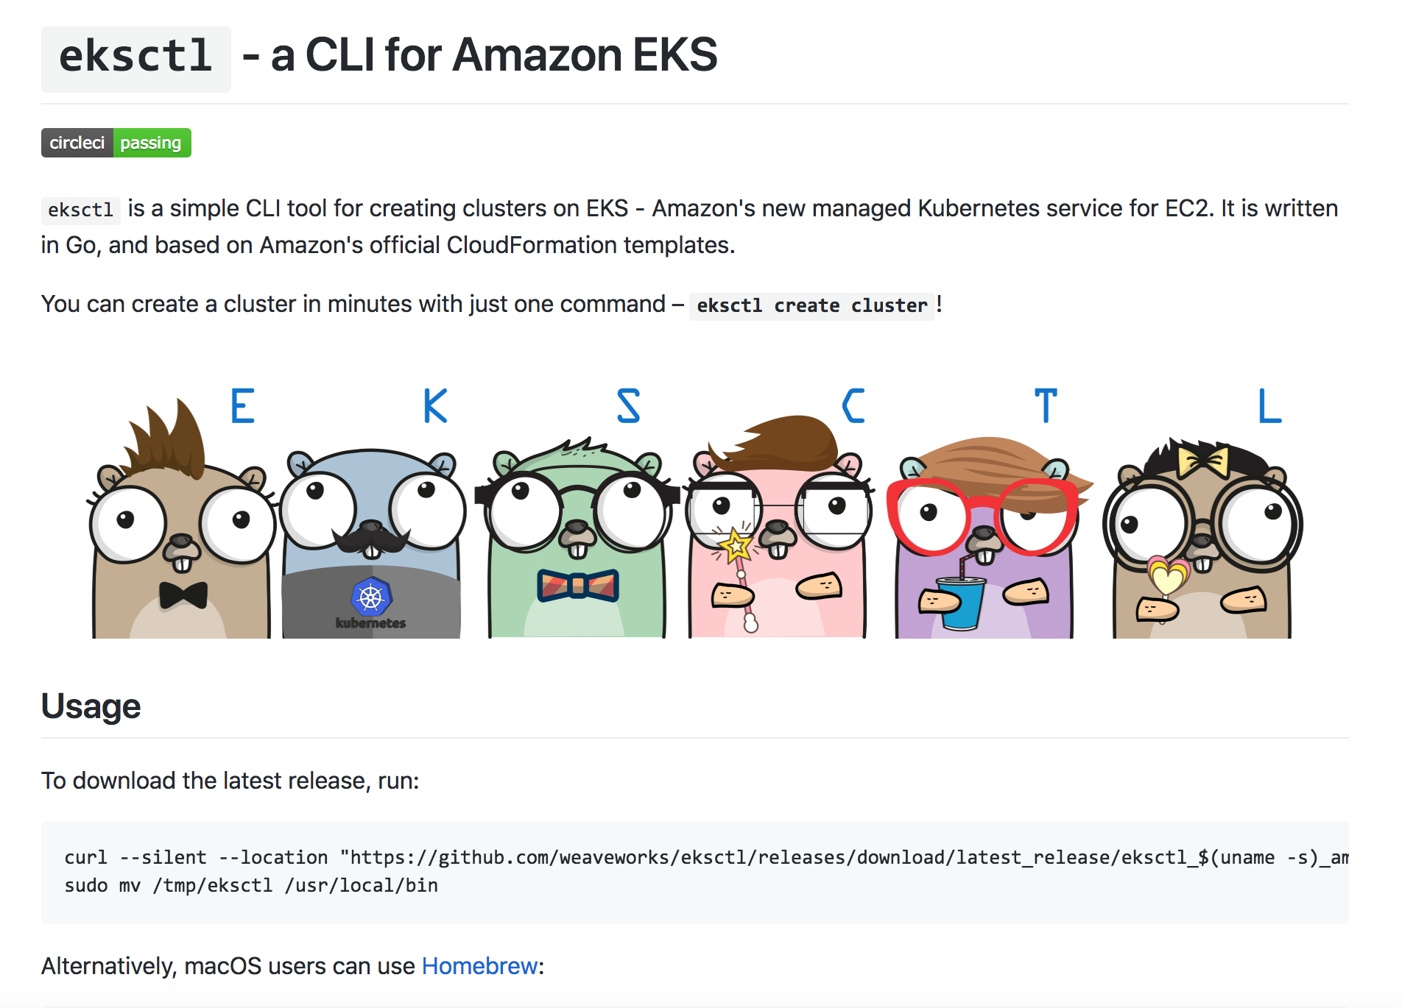
eksctl

Slide 31
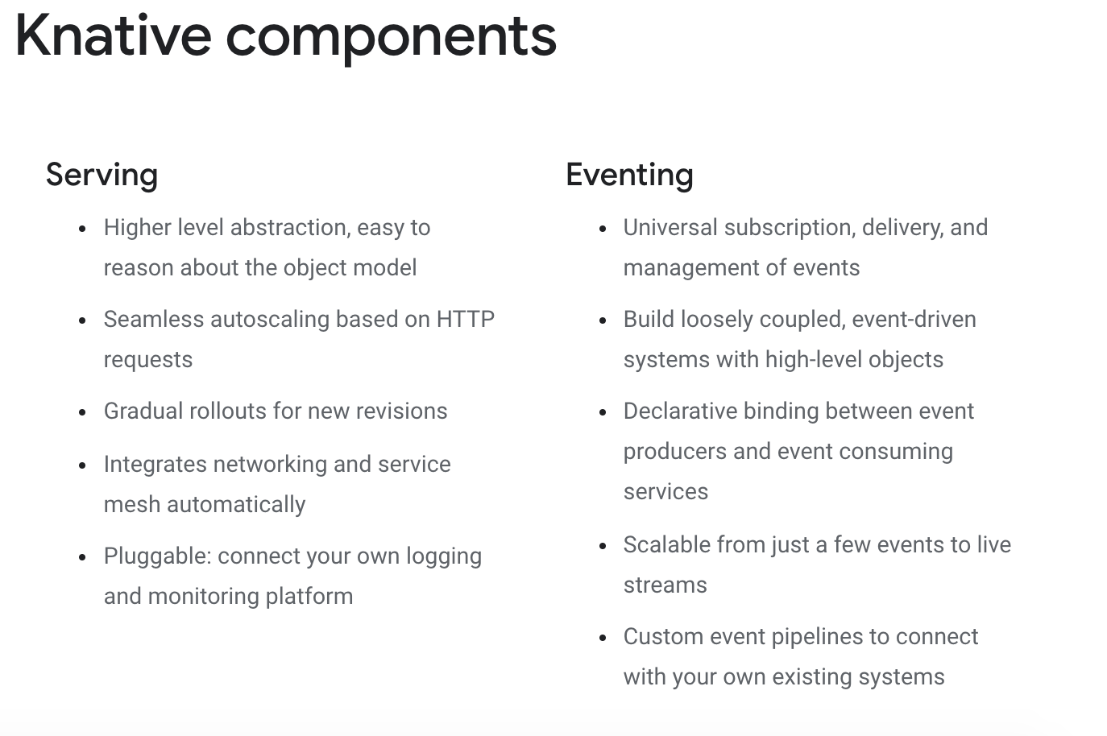
knative

Slide 32
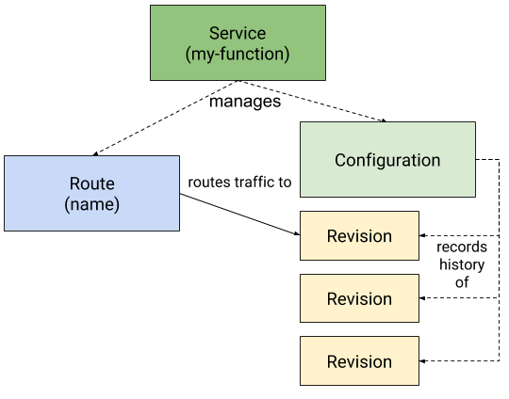
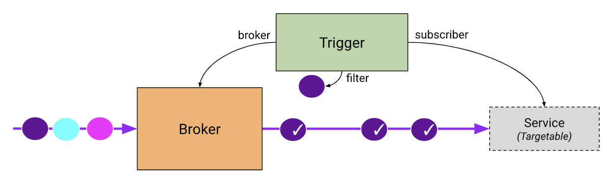
knative
Pronounced “kay-native”
Serverless for Kubernetes
Serving
0-n scaling for workloads
Blue-green deployment and versioning
Eventing
Pub-Sub type messaging for k8s
Distribution of events to serving components
Pipelines and fanouts

Slide 33
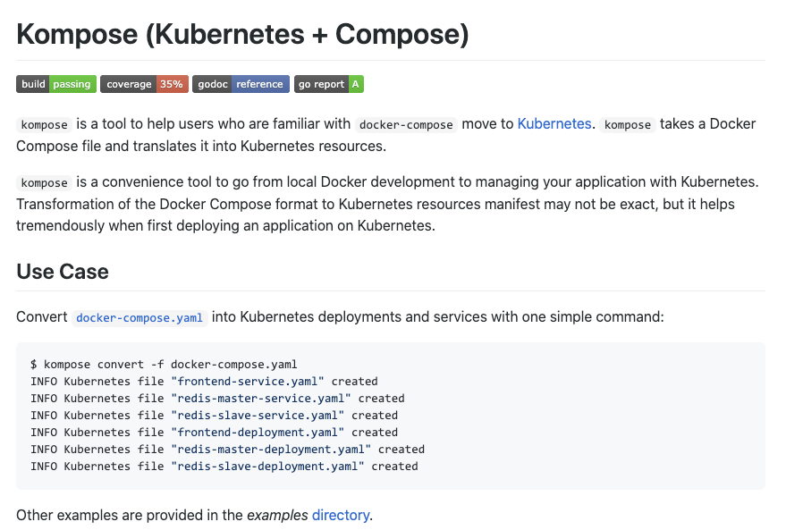
kompose

Slide 34
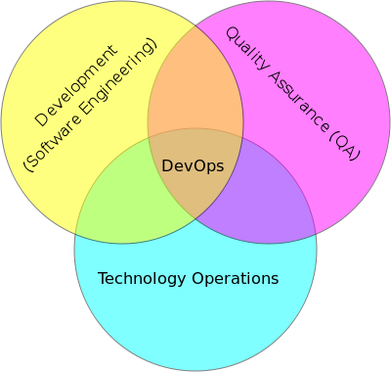
DevOps

Slide 35
DevOps
DevOps is the codification of the interface between Development and Operations
Agile
Repeatable
Collaborative
Versioned
Automated

Slide 36
Cloud and DevOps
It could be argued strongly that the rise of DevOps is tied to the rise of Cloud
Clear requirement for automated, repeatable configuration and deployment
Reducing the hardware provisioning time has highlighted the challenges

Slide 37
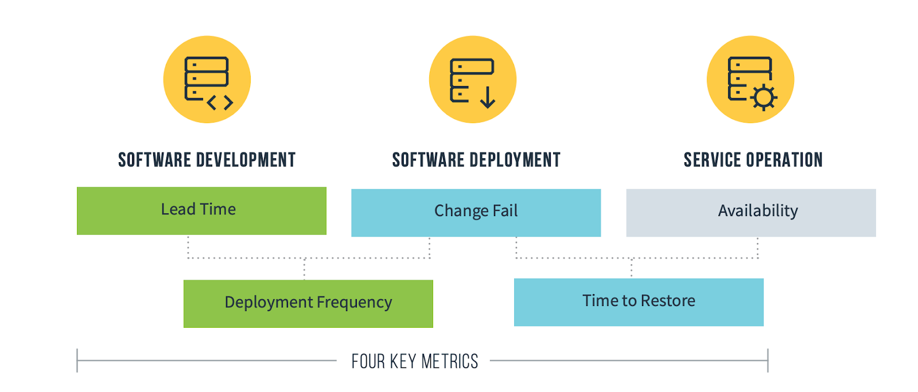
DORA metrics
Deployment Frequency—How often an organization successfully releases to production
Lead Time for Changes—The amount of time it takes a commit to get into production
Change Failure Rate—The percentage of deployments causing a failure in production
Time to Restore Service—How long it takes an organization to recover from a failure in production

Slide 38
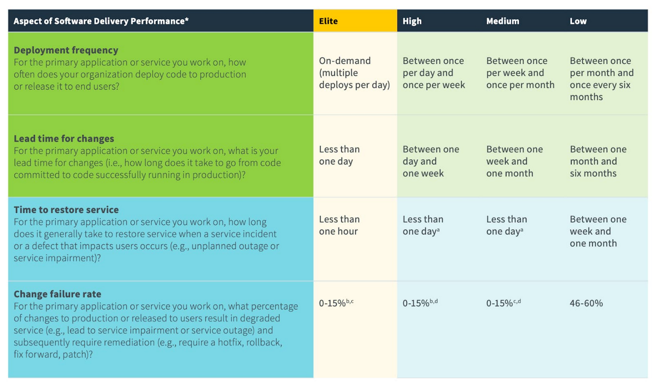

Slide 39

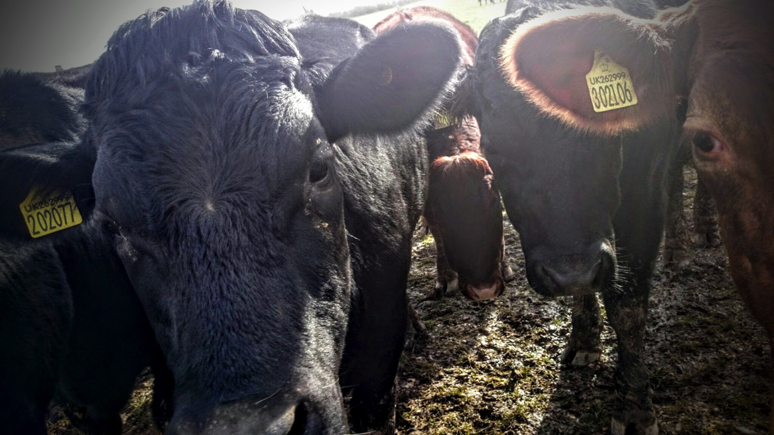
Kittens vs Cattle (An unpleasant but effective analogy)

Slide 40
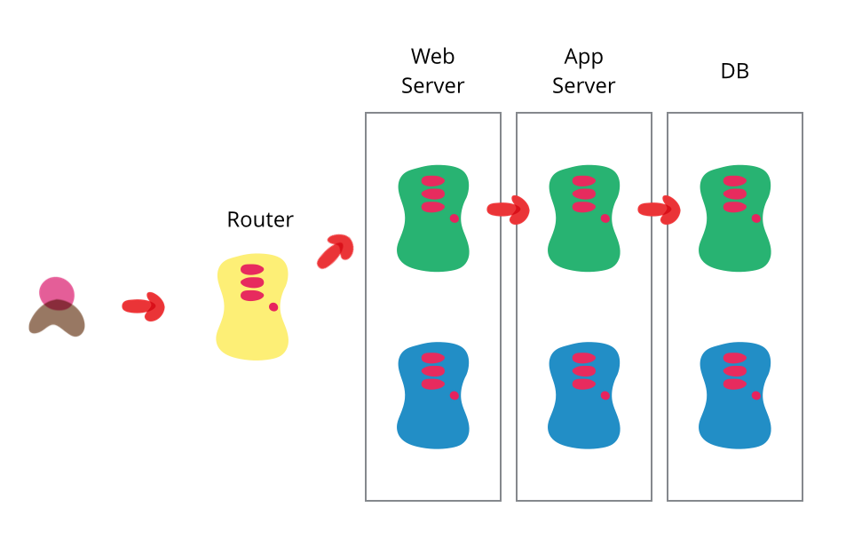
Blue Green Deployment
http://martinfowler.com/bliki/BlueGreenDeployment.html

Slide 41
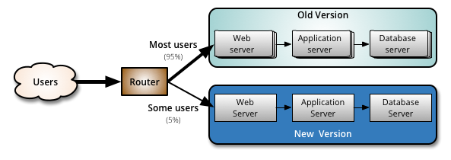
Canary Deployment

Slide 42
DevOps tools
Puppet, Chef, Ansible
Automated configuration and deployment tools
Allow complex infrastructures to be re-configured automatically
Vagrant
Create VMs instantly
Plus many many more!

Slide 43
DevOps and Docker
Docker is a key DevOps tool
Speeds up the creation of repeatable deployments
Consistency between development, test and production
Versioned repository
Works with Chef, Puppet, etc

Slide 44
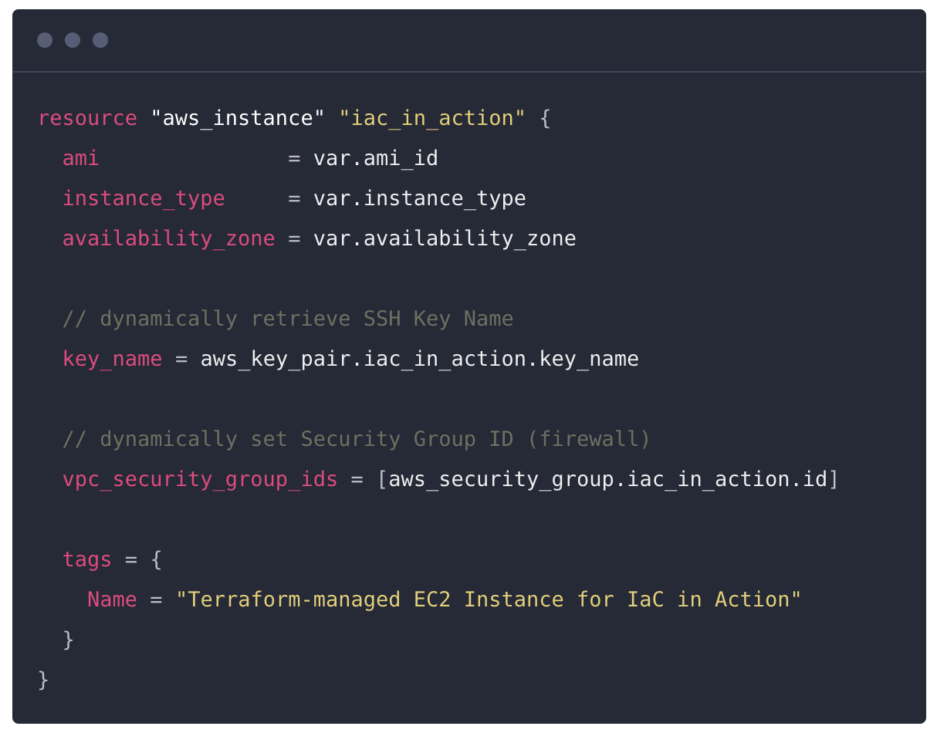
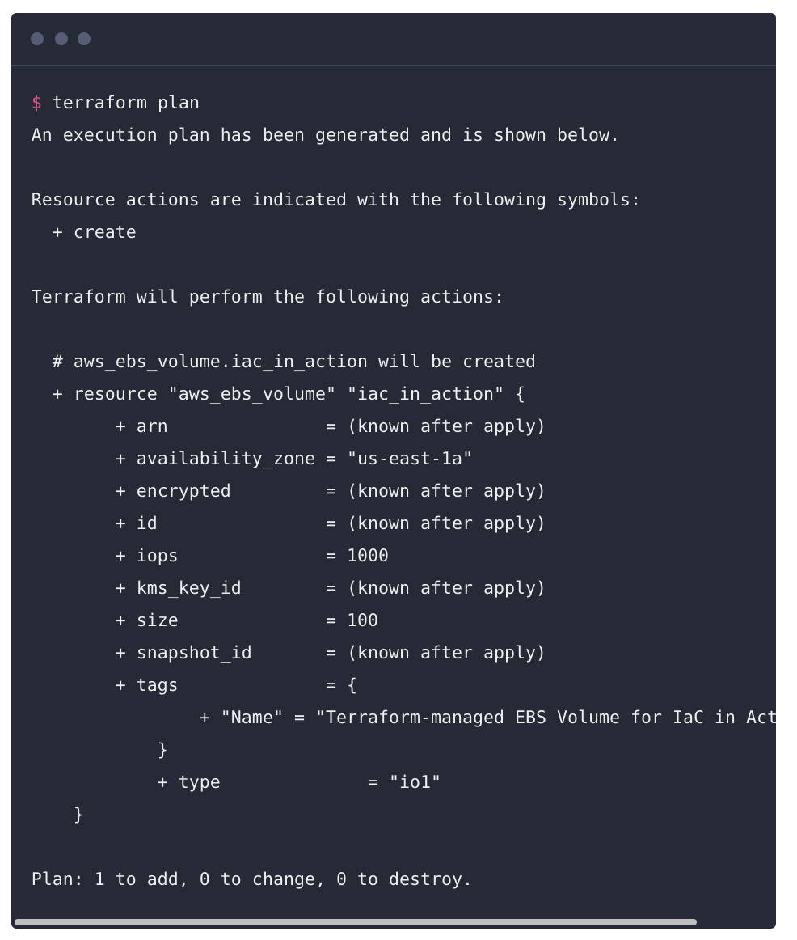
Terraform

Slide 45
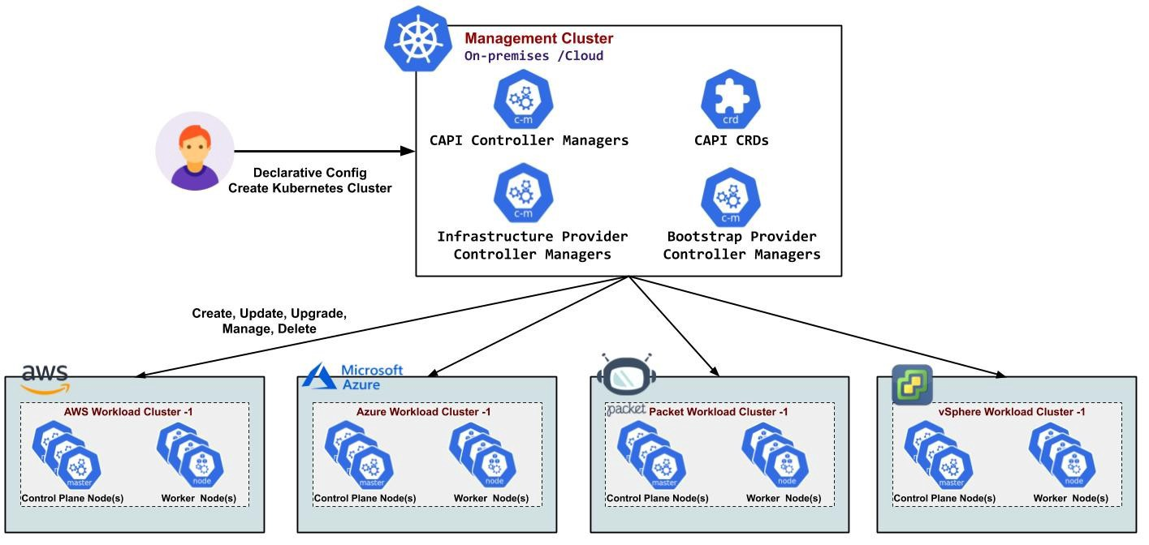
Kubernetes Cluster API (CAPI)

Slide 46
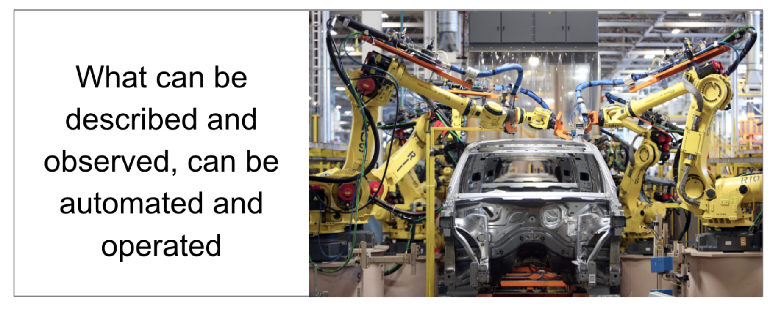
https://www.weave.works/blog/gitops-git-push-all-the-things

Slide 47
Mettle Case Study
Mettle is a business banking brand of NatWest bank. Designed to provide an agile banking experience for small business.
The team is using AWS and Kubernetes to build a completely new technology stack
Using the GitOps approach the team have been able to revolutionise their agility and reliability
Overall developers can now spend 75% more of their time working on creating new features and business value
GitOps also improves reliability dramatically. The team can rebuild their entire system in just 20 minutes. This is a revolution for Mean Time to Recovery (MTTR)
Developer Productivity
Deployment Speed
65%
time saving
50%
faster
Deployment Frequency
Reliability
75%
increase
20 min
MTTR
Notes:
Steve Wade - Platform Lead for Mettle
What is Mettle
Mettle is the free digital business account by NatWest that helps small businesses get paid faster and better manage their finances
Why use GitOps?
Chose Flux CD as the Platform Team wanted to leverage a tool that worked with the existing pipeline (Concourse CI)
Wanted to concentrate on building assets to test in specific environments. Having an agent automate the deployment process.
Wanted to improve security and auditability. Separation of Concerns
Why change?
Was using Concourse CI. Biggest challenge was the concourse is imperative (concourse had the ability to CRUD on any cluster). It was a security risk.
Overall feeling?
Both the Platform Team and the wider Engineering Team love what GitOps has enabled. The Platform Team’s biggest principle when implementing Platform v2 was a self-service platform for developers. We want to get out their way and let them innovate. GitOps has helped us achieve this.
The Platform Team is responsible for the creation and deployment of the infrastructure and the Kubernetes clusters. However, now we are empowering the developers to write their own Terraform code to deploy some resources they require to run their microservice, whether that simply be a HelmRelease for Flux or an S3 bucket their microservice requires for storage. We provide our own Terraform modules to simplify this and to ensure best practices are kept.
Before leveraging GitOps we were deploying rogue/in-accurate manifests into the clusters due to not having any linting in our Concourse pipelines for Kubernetes manifests.
Benefits
Frequency of deployments is up 75%
Developers are spending 65% less time on non development tasks
Deployment speed increased 50%
Decreased recovery time to just 20 minutes

Slide 48

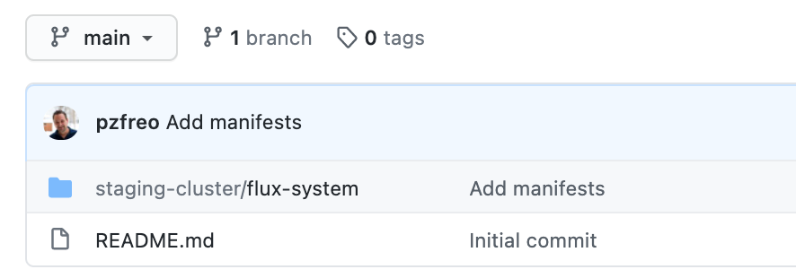
What is GitOps?
Kubernetes clusters
Entirely configured declaratively from Git
Development
Staging
Production
Application workload
Git repo - “workload” - App Team
Container
Container
Container
Container
Dev, staging, prod branches
GitOps runtime
Flux
How it works?
A change is created and tested locally
A Pull Request (PR) against the dev branch is created
The PR is merged
The dev environment automatically pulls this
If there are problems, cluster can be rolled back instantly
Once the dev environment is tested, the change can be merged into staging and then production

Slide 49
What is GitOps?
Kubernetes clusters
Entirely configured declaratively from Git
Git repo - “cluster config” - Platform team
Dev, staging, prod branches
Development
Staging
Production
Application workload
Git repo - “workload” - App Team
Container
Container
Container
Container
Dev, staging, prod branches
GitOps runtime
CAPI
Flux
How it works?
Why?
A change is created and tested locally
A Pull Request (PR) against the dev branch is created
The PR is merged
The dev environment automatically pulls this
If there are problems, cluster can be rolled back instantly
Once the dev environment is tested, the change can be merged into staging and then production
Git is well understood by devs, DevOps and Platform teams
High quality UIs (Github, Gitlab, etc) and CLI tools
Standard workflow for approving changes (and rolling back)
Branches, Pull Requests (PRs), Merges
Every change is approved, authorised and auditable
With the Cluster API (CAPI), this approach can be applied to both clusters as well as workloads
Can be rolled out to multiple clusters, fleets and edge networks

Slide 50
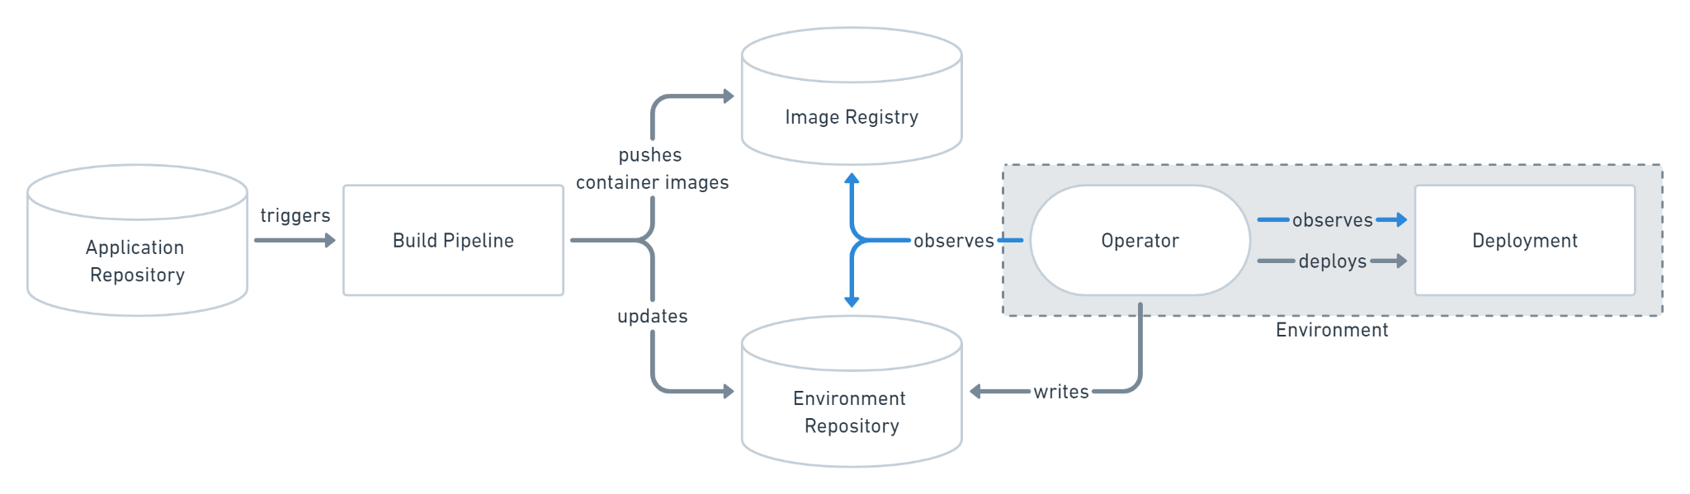
GitOps
https://www.gitops.tech/#what-is-gitops

Slide 51
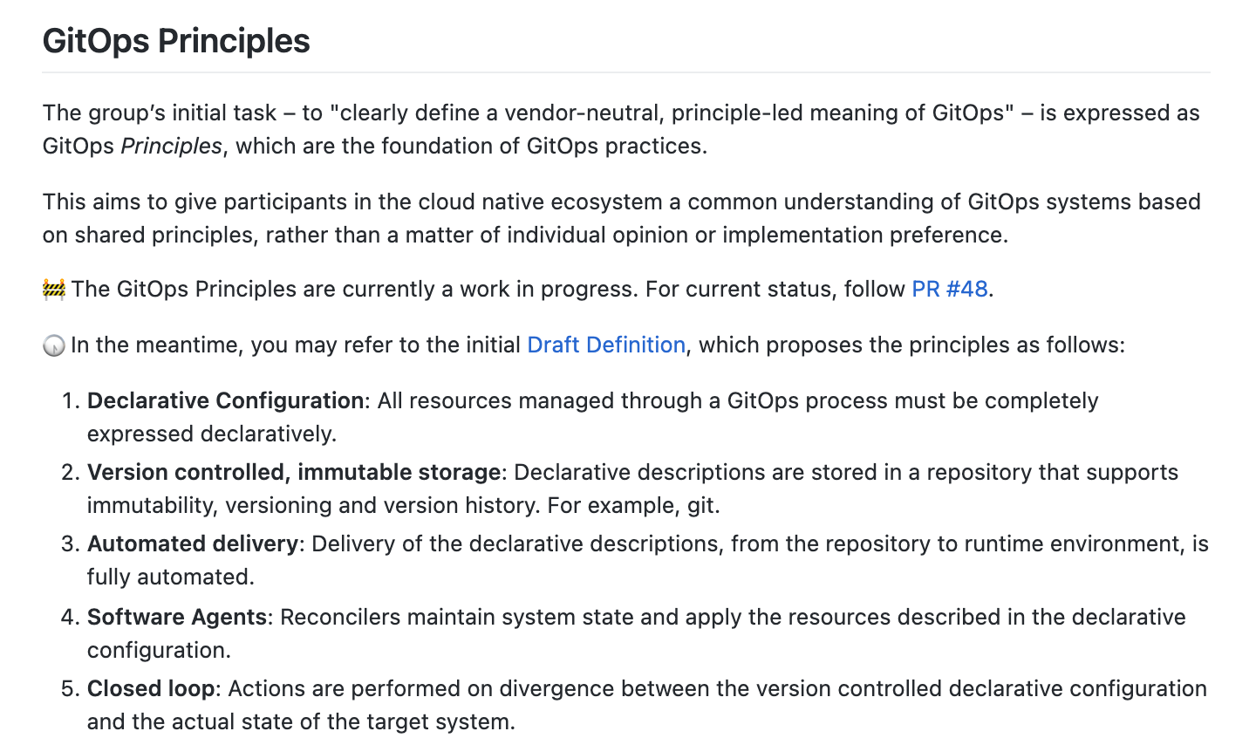
https://github.com/gitops-working-group/gitops-working-group

Slide 52
Questions?

